Slide 1

Supradip Muralidharan
Esport's Business Pitch

Slide 2
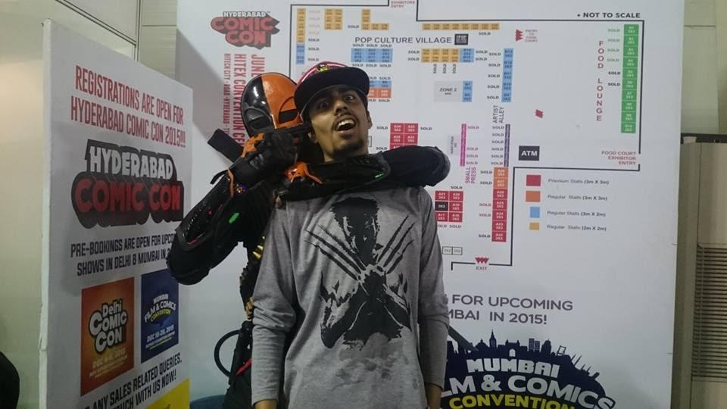
About Me & Team
Mobile App Developer [2017-19], Casual Gamer, Watching Esports from 2015
Solo Founder (hope you don’t reject me for this, I’m more than what meets the eye)
Researching Esports Industry from 1.04.2020
Spoke to players of dota2, pubg, csgo
Spoke to 1 streamer & 2 gaming influencers
Identified a working business model
Built a visual prototype
Built a small pipeline of marketing agencies and brand personnels
This ppt is just a sample, I’ve much more perspective & info need a chance to present it!! Work References: Pransata Sanyal, MD of Bright Edge Edusystems Pvt Ltd Pranshu Diwan, Head of Insurance at Ola Ruchir Kanakia, Founder at Stealth Insurance Startup

Slide 3
What is Esports?
Electronic sports. Same as normal sports model except this is over the internet / online
‘ Professional gamers (who are best at the game) ’ compete either as Single-Player [individual] or Multiplayer [team].
They compete in tournaments & complex games [IQ > 120]
Cash Prize distributed to everyone participating in tournaments (1st,2nd & 3rd)
Spectator Sport

Slide 4
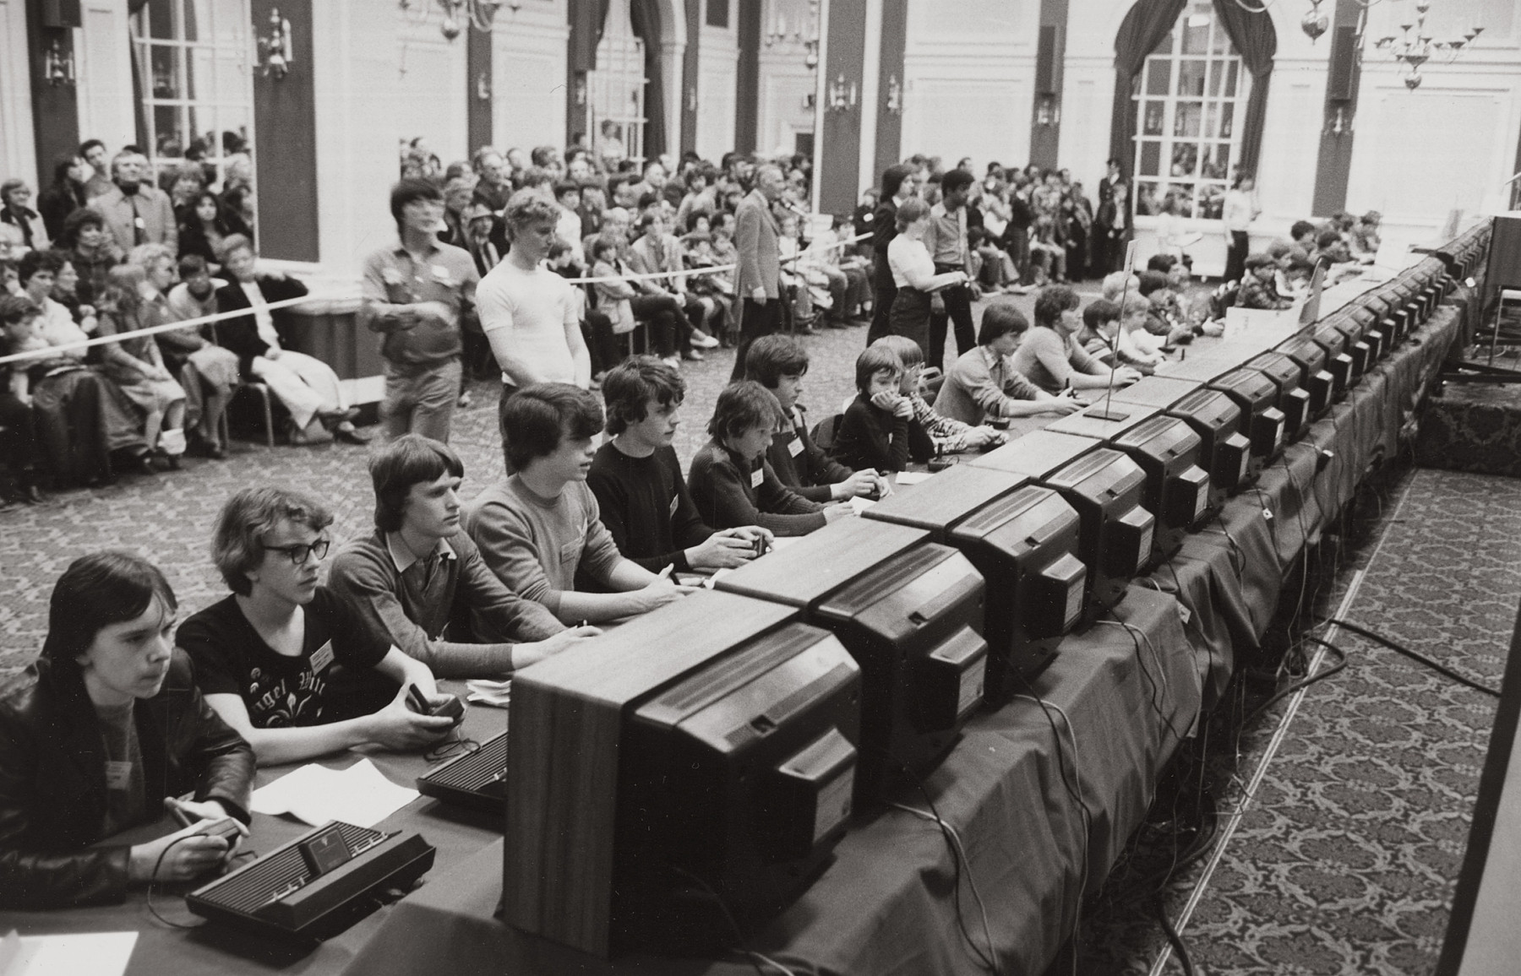
1972 in Stanford university. Space Invaders Championship 10,000 participants

Slide 5
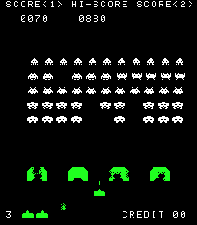
Space Invaders Championship In-Game

Slide 6
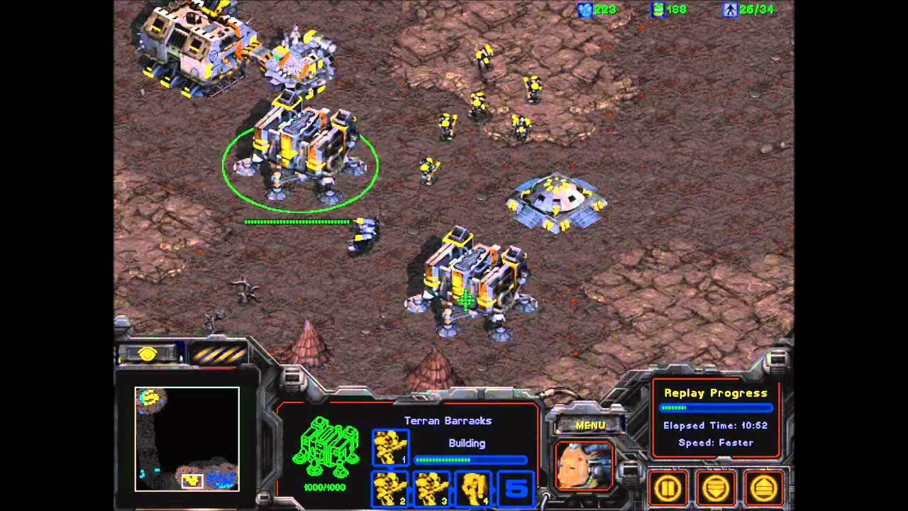
1998 Tournament Game - (Starcraft 2) Viewership - (50 million)

Slide 7
Some games that were played massively during 1999 to 2006->

Slide 8
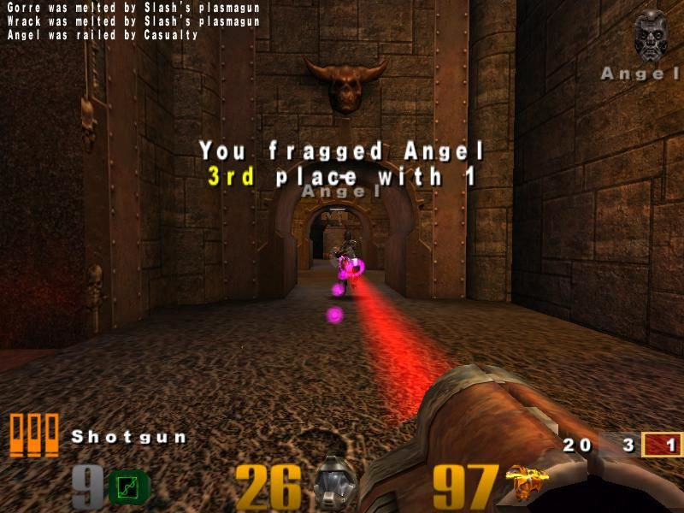
1999 Game - Unreal Tournament 1 [Multiplayer]

Slide 9
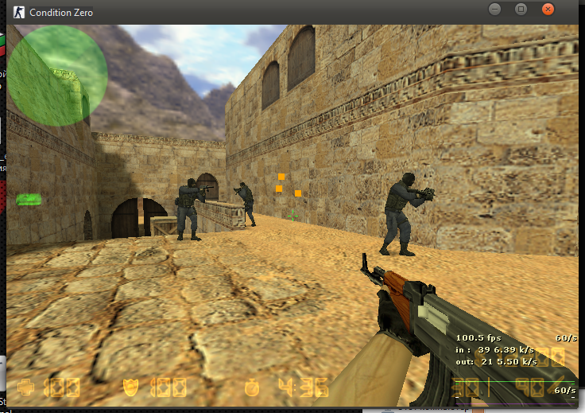
2000 Game - Counter Strike 1.6 [Multiplayer]

Slide 10
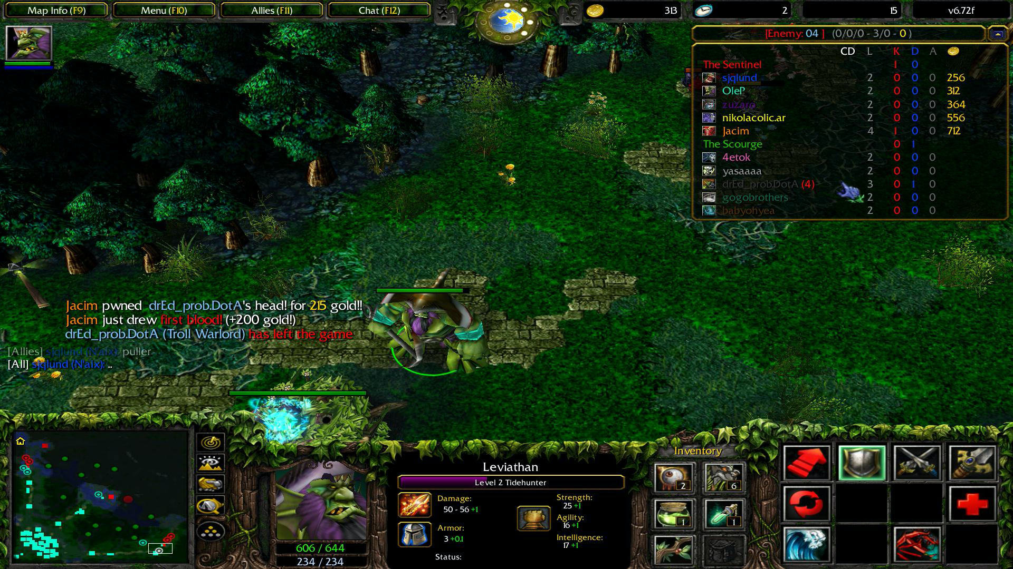
2003 Game - Dota 1 (Defence of the Ancients) [Multiplayer]

Slide 11
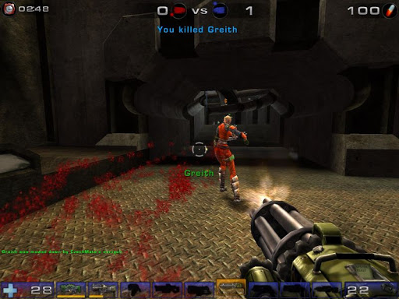
2006 Game - Unreal Tournament 3 [Multiplayer]

Slide 12
Post 2010 how have the games evolved? ->

Slide 13
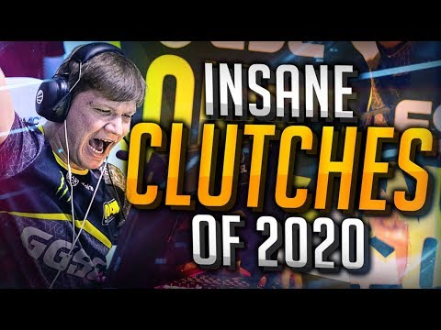
2012 Game - Counter Strike Global Offensive [5 v 5 Multiplayer]

Slide 14
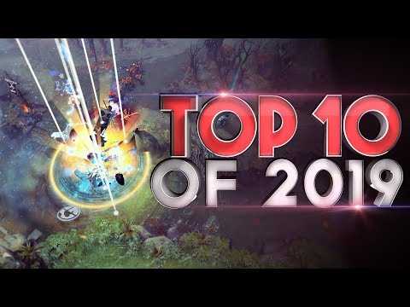
2013 Game - Dota 2 [5 v 5 Multiplayer]

Slide 15
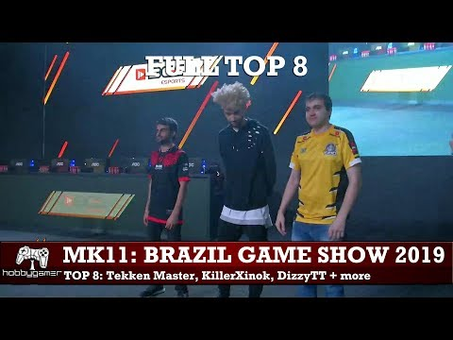
2019 Game - Mk11 [1 v 1]

Slide 16
E-sport Game Categories? ** Watching those videos did it excite you???
First-person shooter (FPS) like Call of Duty, Battlefield, and Halo
Multiplayer online battle arena (MOBA) events like League of Legends and Dota 2
2D / 3D Fighting games like Mortal Kombat, Tekken & Super Smash Bros
Sport games like Madden, NBA2K, FIFA
Others like card games and real-time strategies

Slide 17
How does this industry function?
League Registrations : All the teams pay specified amount and register. Winner takes all!
Sponsored Leagues : Companies wanting to market their brand/product to the gaming audience can sponsor a tournament.
Just like any other sports you’d need media rights to broadcast e-sport tournaments. Customers pay for a ticket and come to watch the game.
Branding, Sponsorships, Promotions & Advertisement.
Teams are owned by business entities or bootstrapped. One or multiple teams are owned by business entities. They give contracts to players. The prize pool is split between players and owners. Also any deals that players do company takes a cut. If failing to perform they shut down or transfer them. Coaches, Operations Manager & Accounts are some positions.
Players are top pros in the game. They stream games (youtube / twitch) trying to gain recognition. Pros get signed and typically sleep & work in a gaming house. 14 hour work day. They do influencer marketing for gaming products. ESL → Electronic Sports Leagues

Slide 18
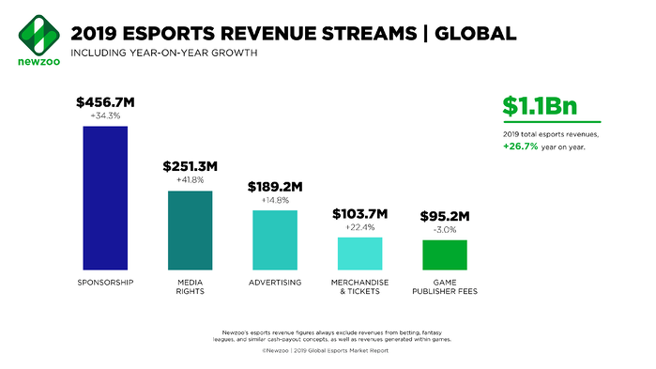
Let’s look at the data of this industry - 1

Slide 19
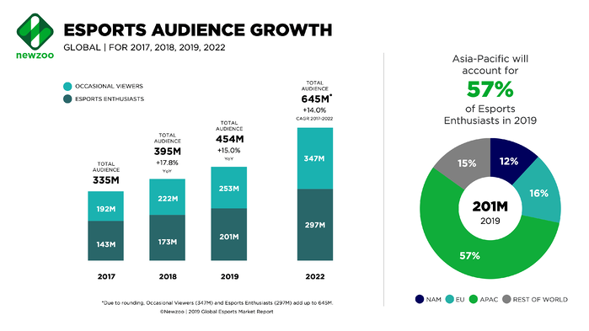
Let’s look at the data of this industry - 2

Slide 20
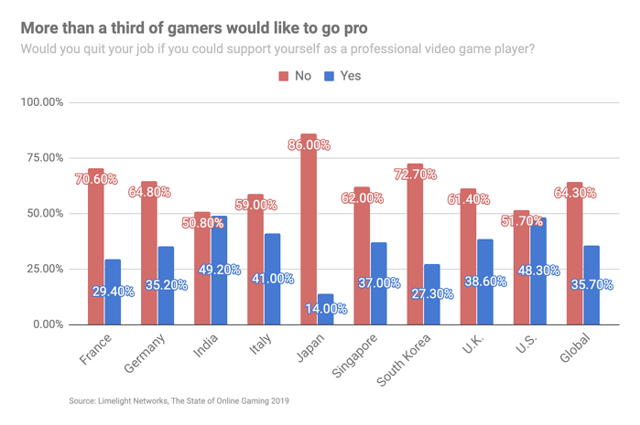
Let’s look at the data of this industry - 3

Slide 21

INDIA:
What is happening here?

Slide 22
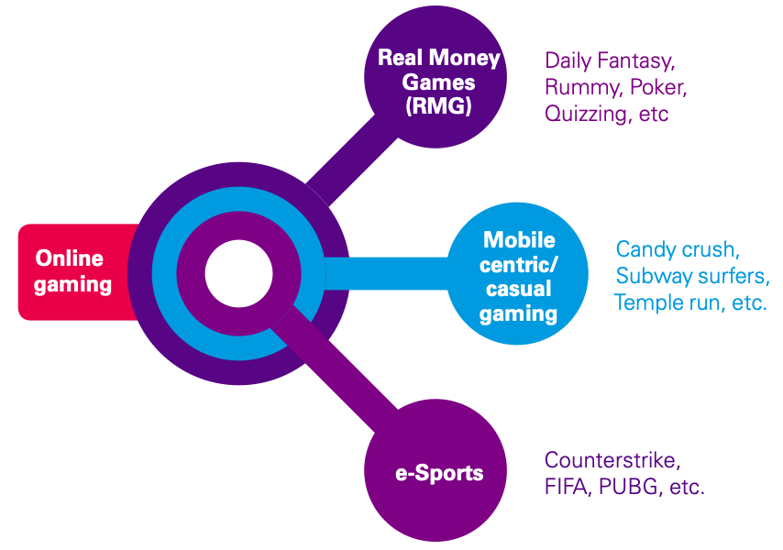
Let’s look at Indian Data - 1

Slide 23
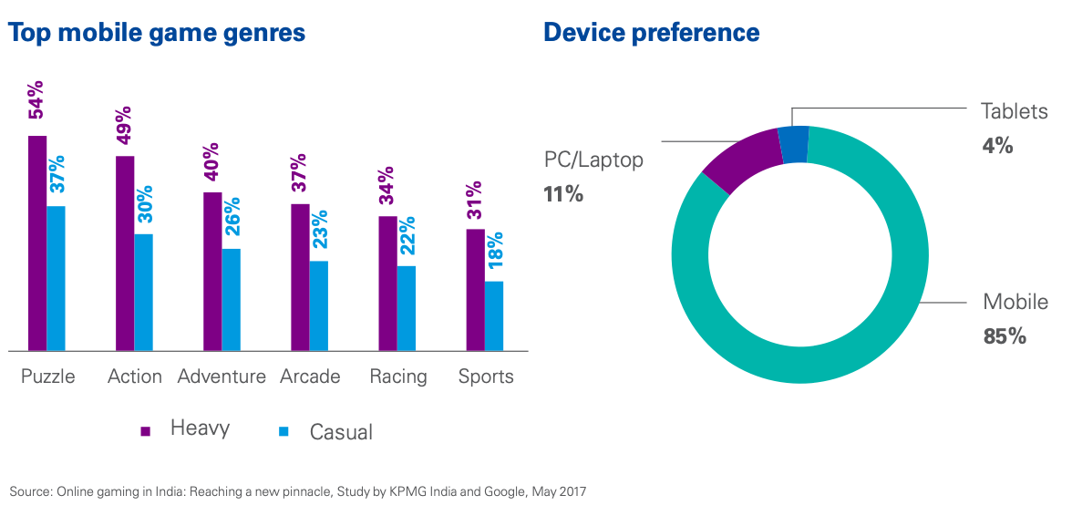
Let’s look at Indian Data - 2

Slide 24
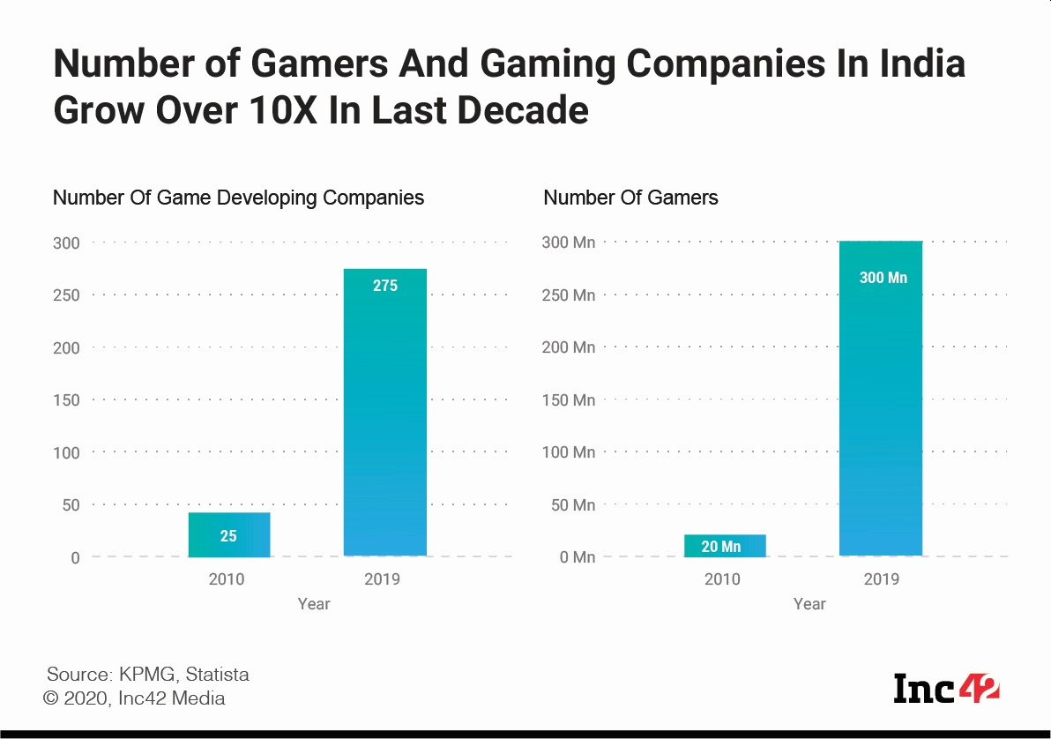
Let’s look at Indian Data - 3

Slide 25
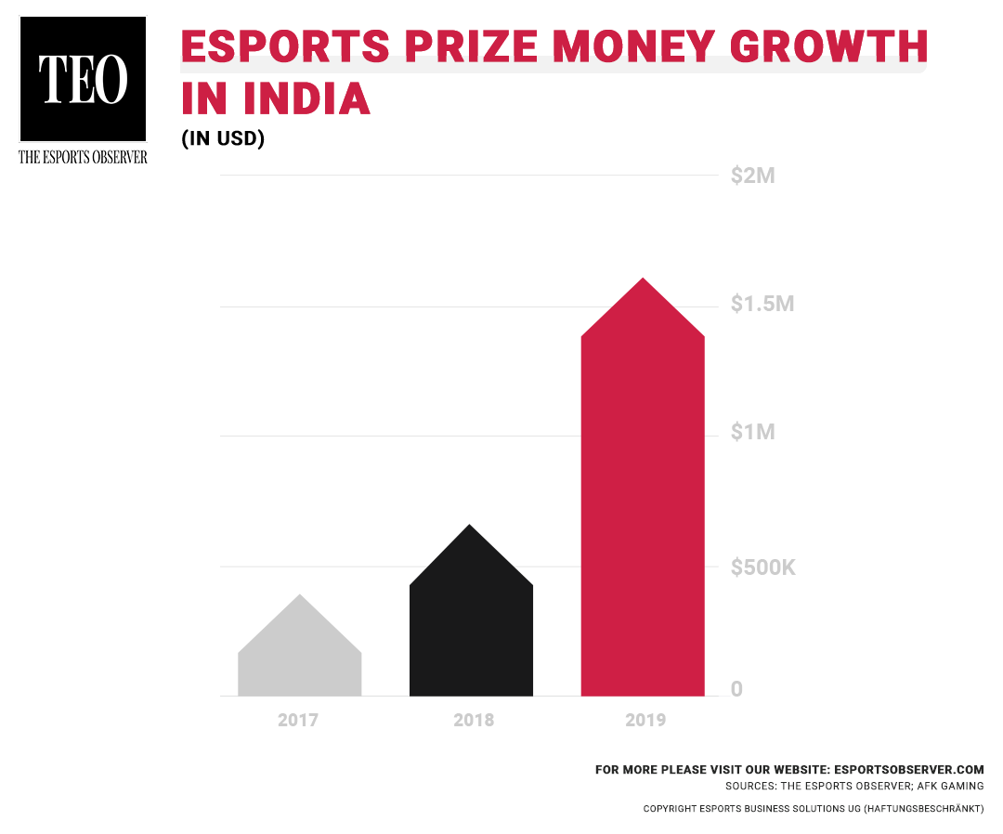
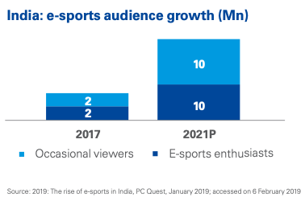
Let’s look at Indian Data - 4 [180% growth]

Slide 26
This is a ‘serious business’ not some ‘casual pass time’..
Let me show you who all are in this game already

Slide 27










Indian Esport Teams

Slide 28







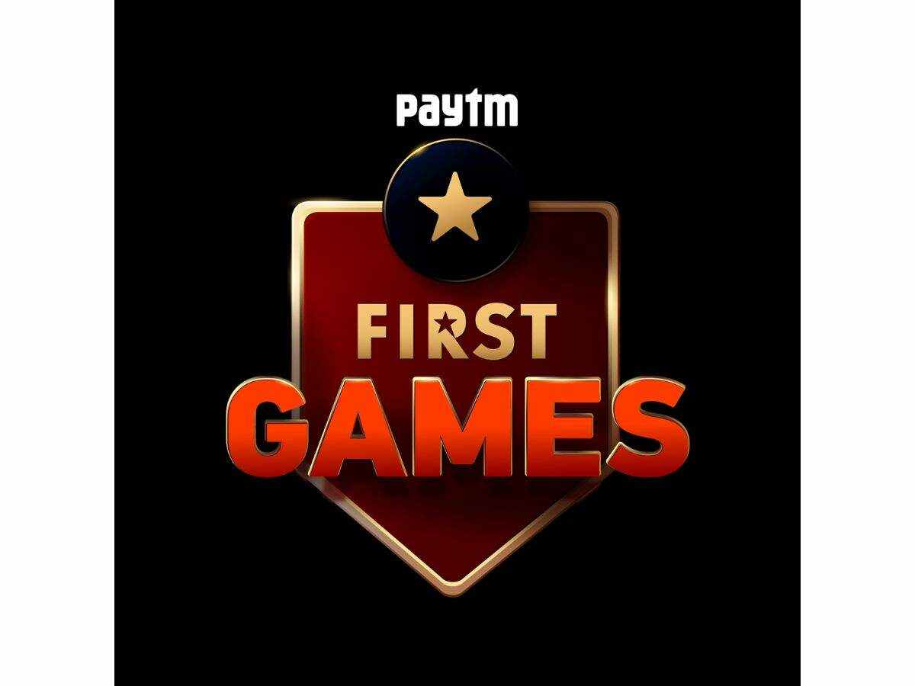


Indian Esport / Game Tech Companies

Slide 29
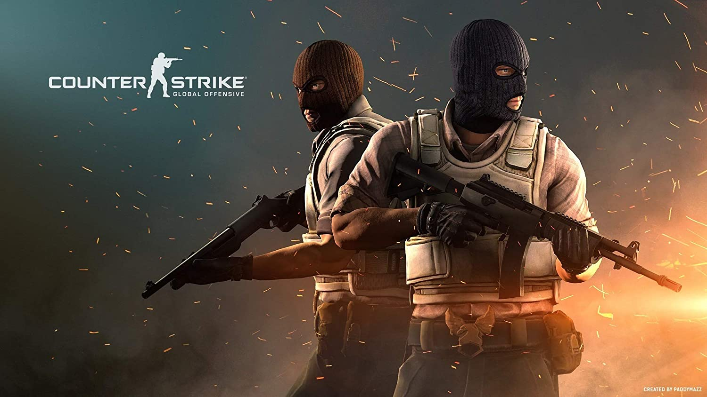
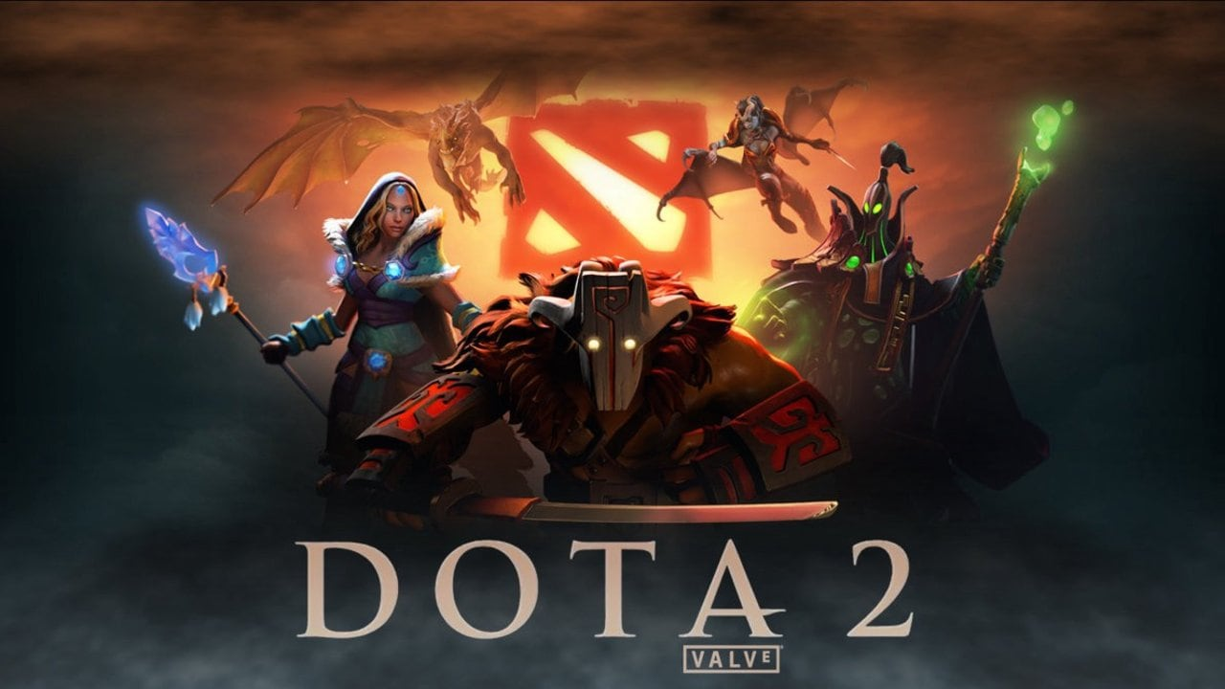
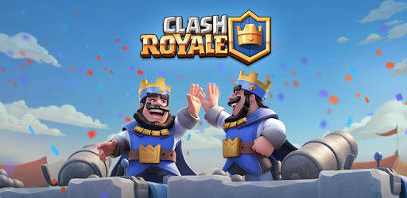
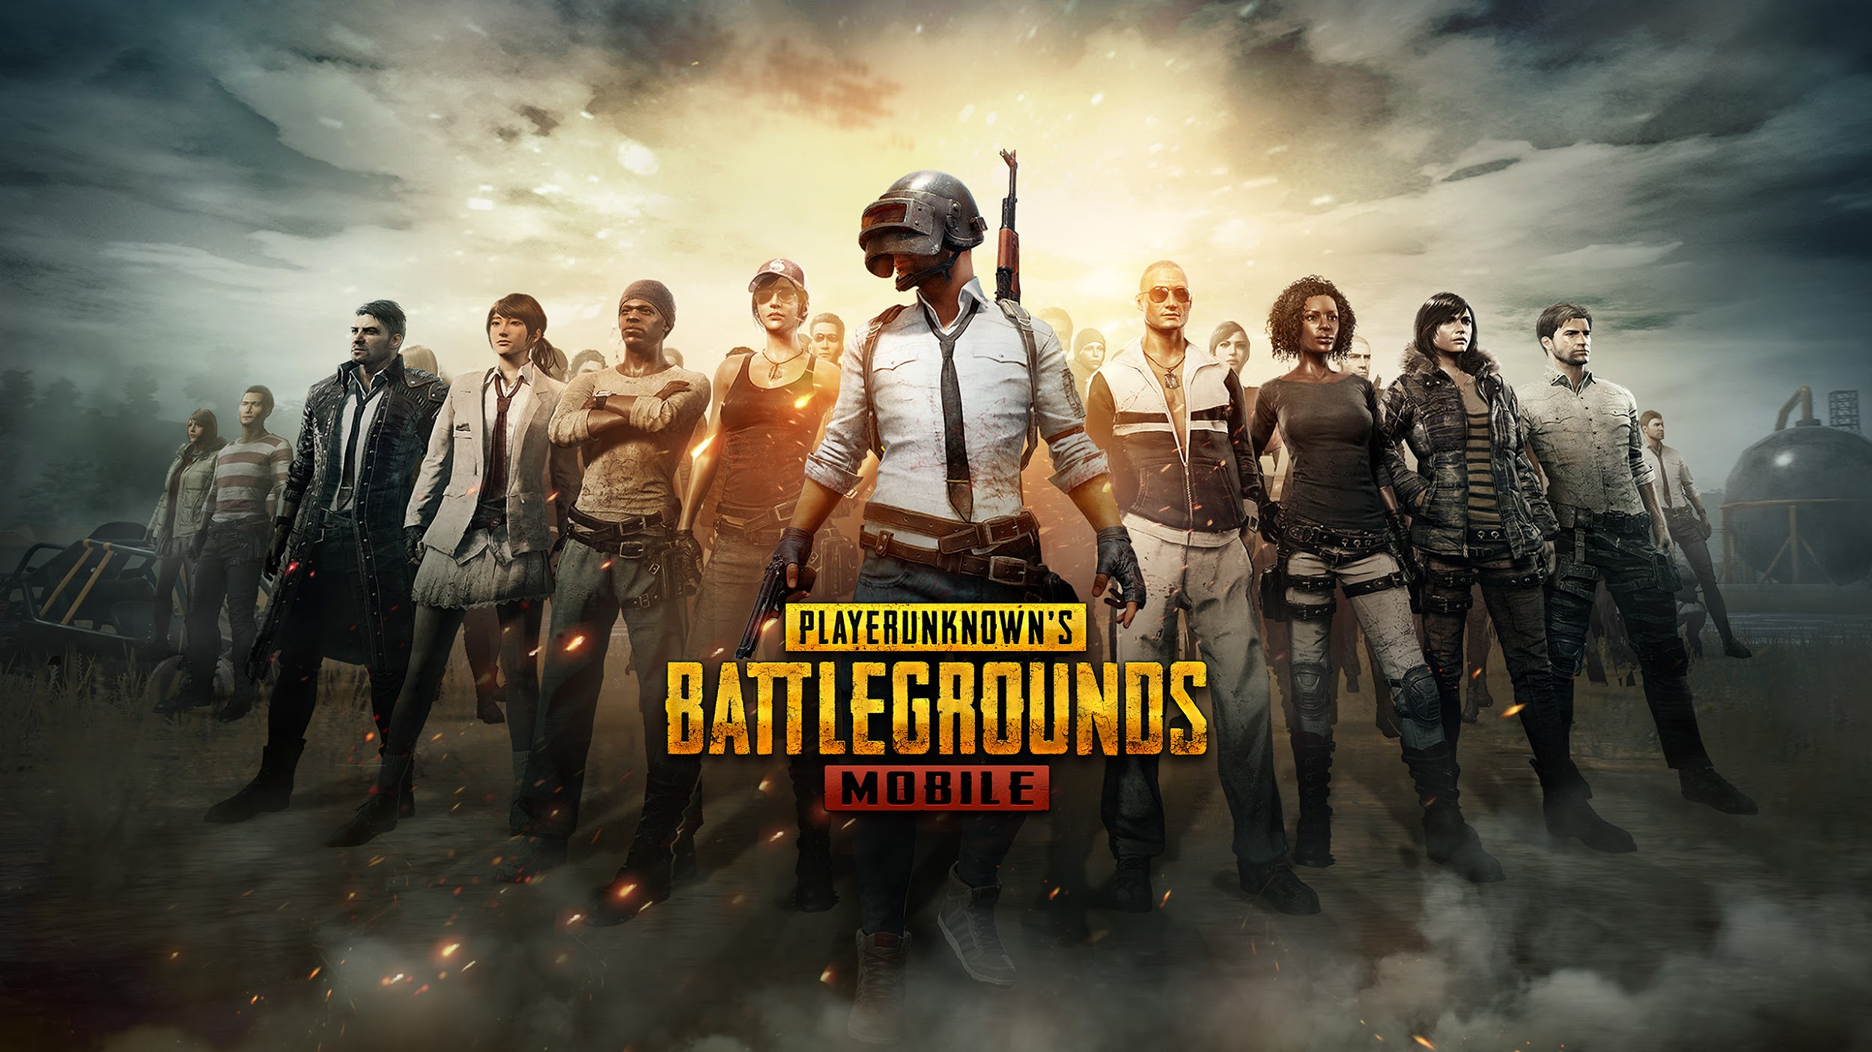
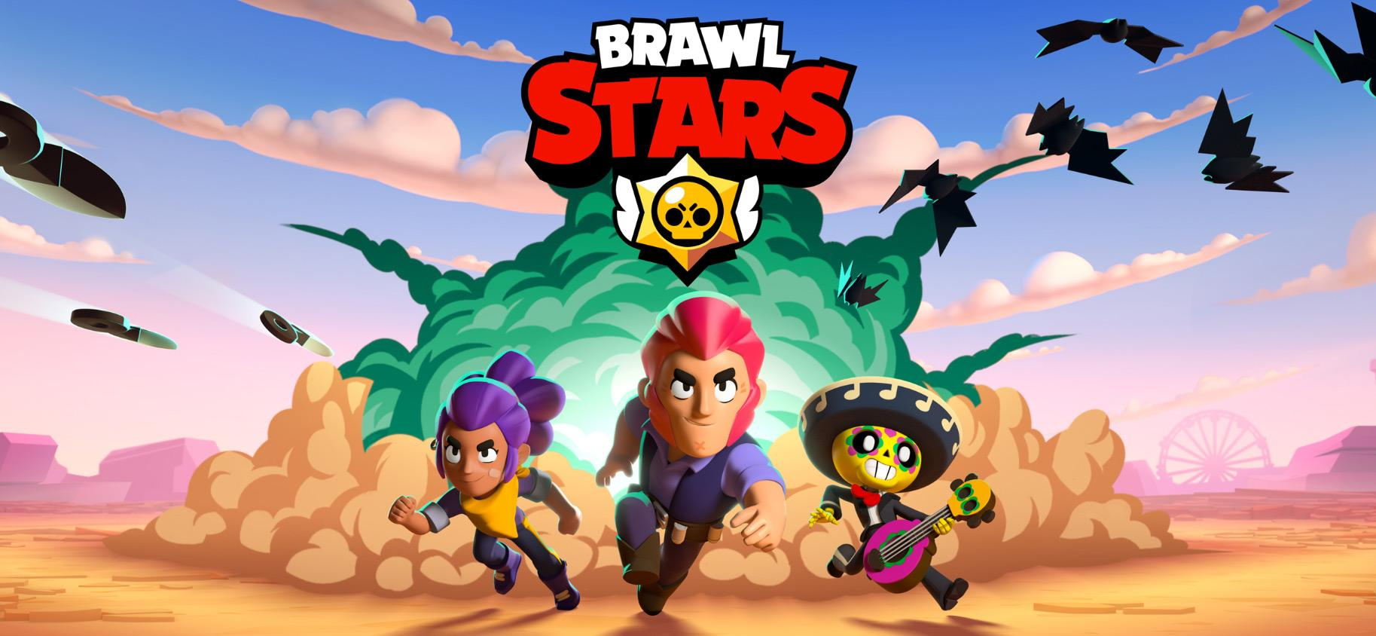

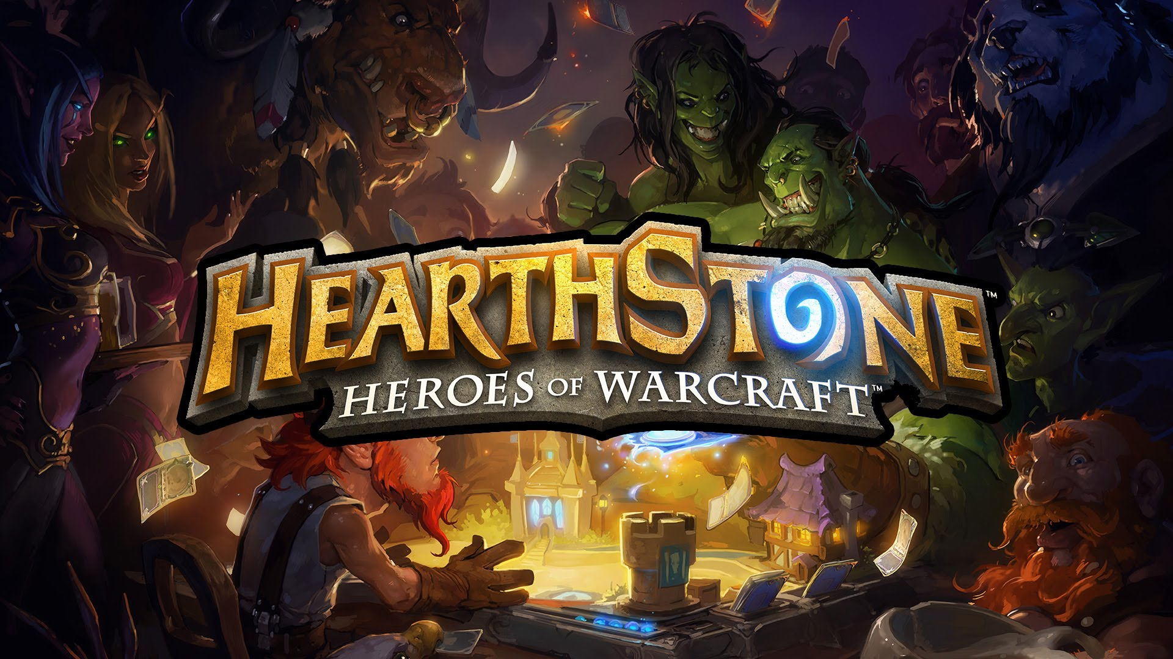

Esport Games played by Indian Pros

Slide 30

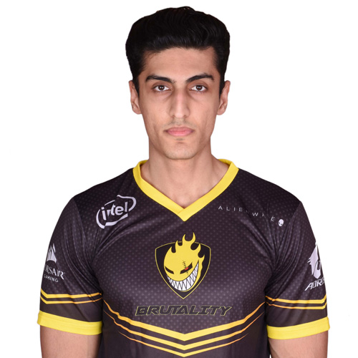
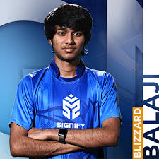
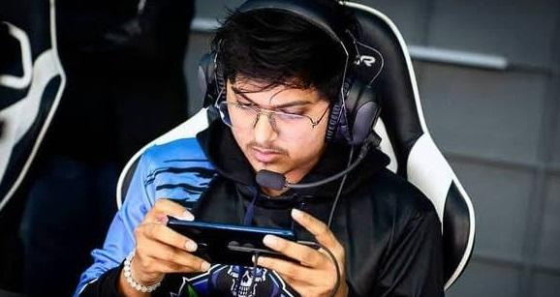

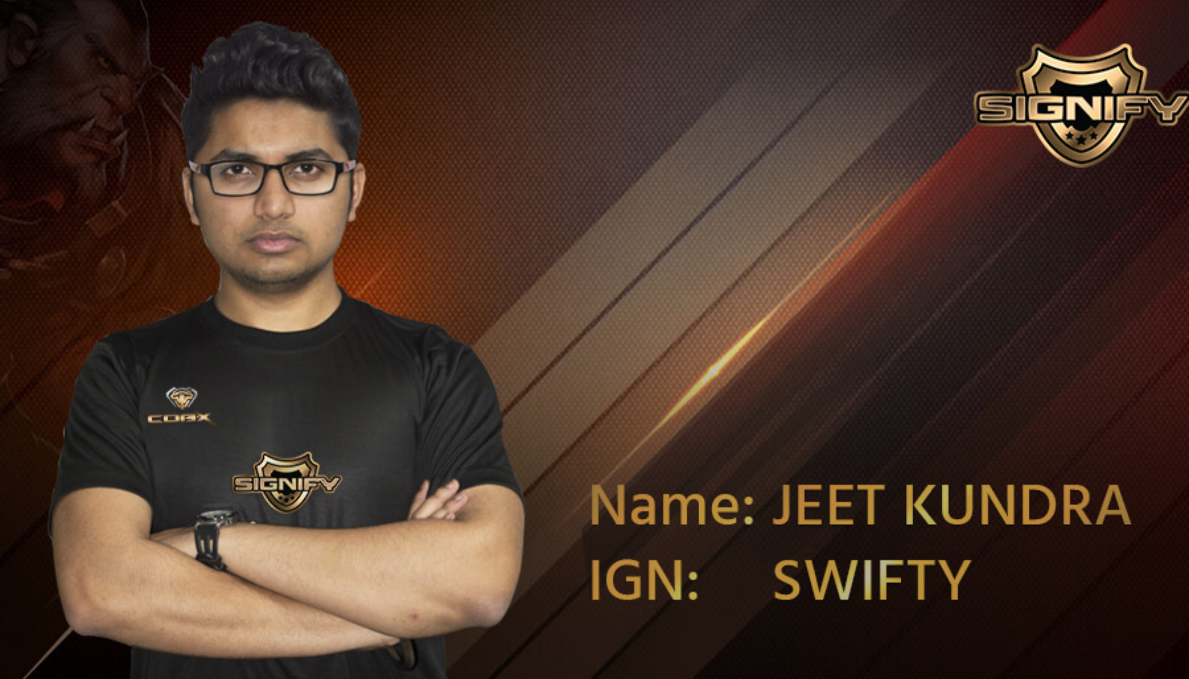
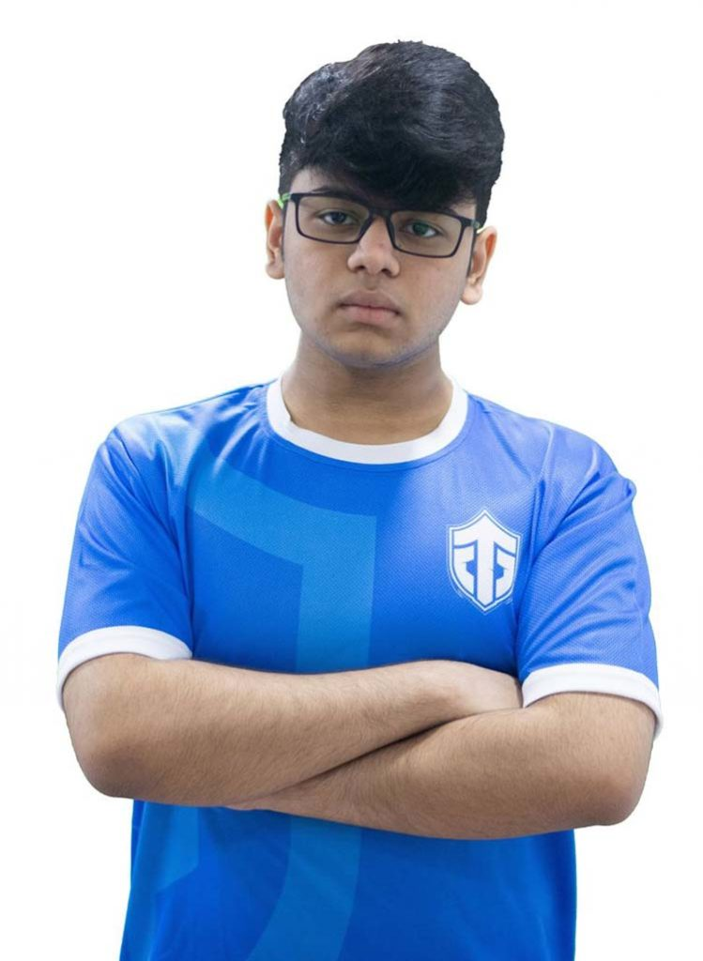
Top Indian Esport Players

Slide 31
Problem Statement:
Where & how did I find this info?
Where can I find ESL Tournaments?

Slide 32
How is it being done today?
Tournaments are being advertised through Content Creation [fb,Ig,LIn,Discord,YT.. Etc], Second problem with companies is that they’re advertising all kinds of things like new player entry, gaming products, scores..etc
Some Gamers discover tournaments when they’re in-game, i.e. Game dashboard
Newsletters / Email promotions
Word of Mouth

Slide 33

V1 - One website for all E-sport Tournaments Info

Slide 34

The solution
|
V
Website (No-App) [Mobile Responsive]
Create a centralized place for all info related to tournaments, leagues, teams and players.

Slide 35
Revenue model
Event / Tournament Organisers
Our Product
Customers
B2B2C
B2C : Monetise the website with targeted ads from gaming companies or products from that space.
B2B : Subscription Plans or Pay Rs for creation of event / tournament

Slide 36
Audience
Esport Organisations
Esport Enthusiasts
Professional Gamers
Casual Gamers
Talent Management Companies
Brands, Advertisers, Sponsors of Gaming Industry
Normal Citizens

Slide 37
Where are the places we can go?
Presenting Live score of tournaments [v1.2]
Can handle payment for customers wanting to go for an event [v1.5]
Data hub of INDIAN teams, players [v2] and tournaments
Publishing of Industry Reports (Yearly / Half-yearly)
Can be a job portal or communication platform between players and teams [Aspiring & Professionals]
With the data collected can pivot to sports talent agency

Slide 38

Competitors:
https://esportsflag.com
https://liquipedia.net
https://www.esportsearnings.com
https://esportsone.com https://www.toornament.com/en_GB/
There are some more but all in nascent stage

Slide 39

Why now?
Timing is the most crucial part of this business.
Esports in India has been there since 2012. Previously tournaments were conducted in silos plus very few audience knowledge. Still there are many misconceptions. It is still in nascent stage. Perfect time to attack and test!
Not many competitors, Can pivot to some different calculated avenues.

Slide 40
References
Google Image Searches for games and game related references
https://learn.g2.com/esports
https://liquipedia.net
https://esportsinsider.com/?s=india
https://homegrown.co.in/article/803783/more-than-just-games-the-rise-of-indias-esports-industry
https://assets.kpmg/content/dam/kpmg/in/pdf/2019/03/online-gaming-india-fantasy-sports.pdf
https://yourstory.com/2020/07/esports-business-prospects-covid-19-impact
https://yourstory.com/2020/04/gaming-startup-gamerji-esports
Other 15-20 articles on Indian Esports

Slide 41
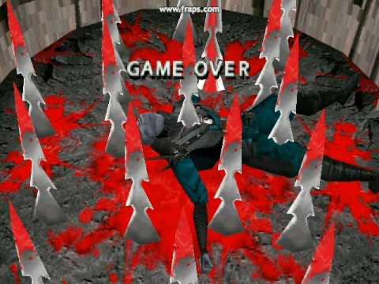
Email - pradip.withu@gmail.com Phone - 7259837601

